Slide 1

DOSRI AMPLIFYING SOCIALLY RESPONSIBLE INVESTING (SRI) PRESENTATION 7
Team 1: Six Underground
Presented by:
Farhan Pasha Mohammed
Samarth Yadav
Harshal Patil
Kush Shah
Jephthe Louis-Jacques
Naga Sai Kiran Nimmakayala
Instructor:
Professor Henry Wong

Slide 2

AGENDA
1. TEAM MEMBERS ROLES 10. PRODUCT BACKLOG
2. PROBLEM STATEMENT 11. SPRINT BACKLOG
3. PROJECT DESCRIPTION STORIES AND ACCEPTANCE CRITERIA
4. PERSONAS TEST CASES FOR STORIES
5. MVP 12. METRICS
6. TECHNOLOGIES 13. RETROSPECTIVE
7. ARCHITECTURE DIAGRAM 14. SPRINT 7 STORIES
8. SPRINT 6 RECAP 15. PROJECT DEMO - GITHUB LINK
9.IMPROVEMENTS
Notes:
COMPLETED

Slide 3




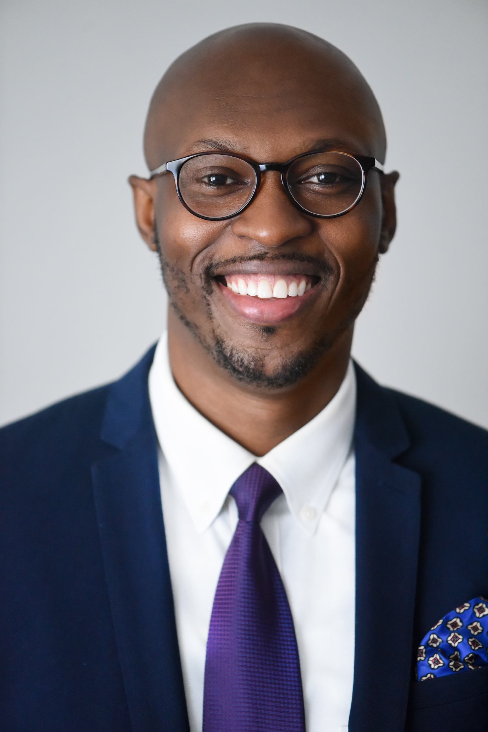

Team Members
Jephthe Louis-Jacques
Harshal Patil
Samarth Yadav
Kush Shah
Farhan Pasha Mohammed
Naga Sai Kiran Nimmakayala
Scrum Master
Developer
QA Analyst
Developer
Cloud Engineer
Tester

Slide 4
PROBLEM STATEMENT
As more investors commit to investing in companies that are socially responsible, these progressive investors struggle to find the metrics that go beyond traditional line items such as traditional performance and expenses. Socially conscious investors struggle to find the metrics that highly business practices that align with their values.
Here is the opportunity we plan to capitalize on, “Dosri” is a free website that provides investors insight about publicly traded companies social rating base on the ‘Environmental, Social, & Governance’ (ESG) standard rating. Dorsi plans on serving this growing community of investors with thorough analysis of company performances that expand beyond traditional financials along with quick access to investing in these Socially Responsible companies.
Notes:
COMPLETED

Slide 5
PROJECT DESCRIPTION
WHAT IS DOSRI?
“Dosri” is a free website that provides investors insight about publicly traded companies social rating base on the ‘Environmental, Social, & Governance’ (ESG) standard rating and more.
Provides investors with latest stock price, related articles and third-party brokerages accounts for creating investment accounts if interested in buying the stock
The differentiator with the site is to amplify Socially responsible investing amongst investors by quickly helping them identify companies that are sustainable, particularly in in the three categories below:
Environmental - Issues such as climate change and pollution
Social - Issues around workplace practices and human capital
Governance - Issues such as executive pay, accounting, and ethics
Socially Responsible Investing (SRI)
Notes:
COMPLETED

Slide 6
PERSONAS

Slide 7
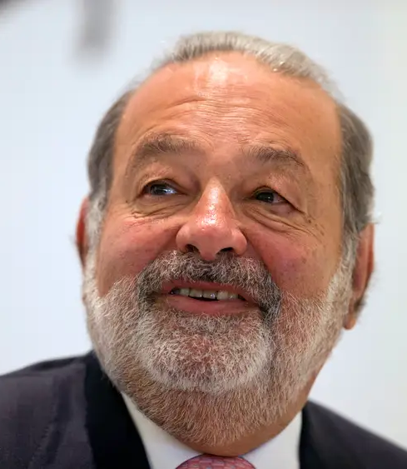
PERSONA 1: CARLOS, PUBLIC SPEAKER
Background Profile:
Carlos, a 60 years old, wealthy long-term investors that does financial public speaking, runs his own family office, always looking for new tools to make better investment decisions
Carlos likes to research companies and read the latest stories about them to quickly identify their long-term financial positions
How Dosri can help?
Carlos can search various publicly traded companies on Dosri and review their financials.
Dosri simultaneously provides google articles related to the searched company for additional insight on performance.
Carlos can search companies on Dosri to gather metrics to better inform his audience of the top performing ESG companies.

Slide 8

PERSONA 2: DONNA, RECENT GRADUATE
Background Profile:
Donna, a 24 years old, recent college graduate that major in product design, currently making 120K USD, identifies as a vegan and cares about the environment.
She sees the value of investing her dispensable money, but she is new to the finance and conscious of companies that are known for conducting unethical practices.
How Dosri can help?
Donna can search various publicly traded companies on Dosri and review their financials.
Dosri simultaneously provides google articles related to the searched company for additional insight on performance.
If Donna is ready to make an investment, Dosri provides quick access links to investment brokerages at real time.

Slide 9
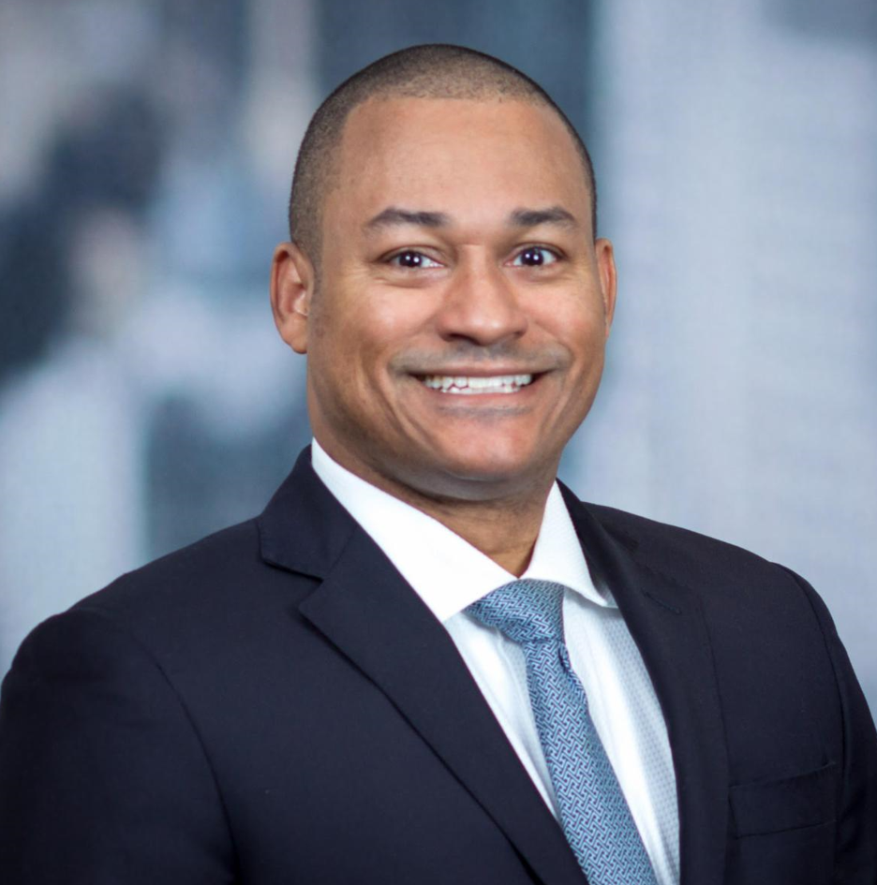
PERSONA 3: PAUL, INVESTOR
Background Profile:
Paul, 26 years old, a recent college graduate working as an investment advisor at a Bank, is aiming to bring more value himself to the Bank and all the customers.
His thinking is not only are investments in socially responsible assets vastly growing. The market shows that this interest stems to a significant extent from investors trying to align their investments with their social preferences.
How Dosri can help?
Dosri helps Paul as he can review SRI companies with a sustainable business plan and can get more accurate information for investment.
Dosri helps provide insights into the company’s financial growth with user friendly UI.
As Paul is completes his review process; Dosri provides quick links to investment brokerages in real-time.

Slide 10
MINIMAL VIABLE PRODUCT (MVP)
Features:
Provide stock price, ESG standard rating, Financial reports for company currently searched
Allow user to login and create password to store historical data
Generate latest online news for company currently searched
Provide quick access third party platform investment firm (Fidelity)

Slide 11

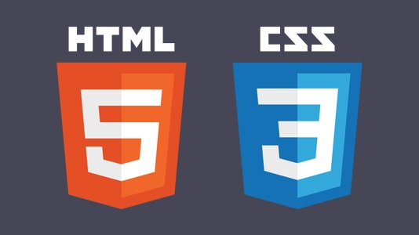



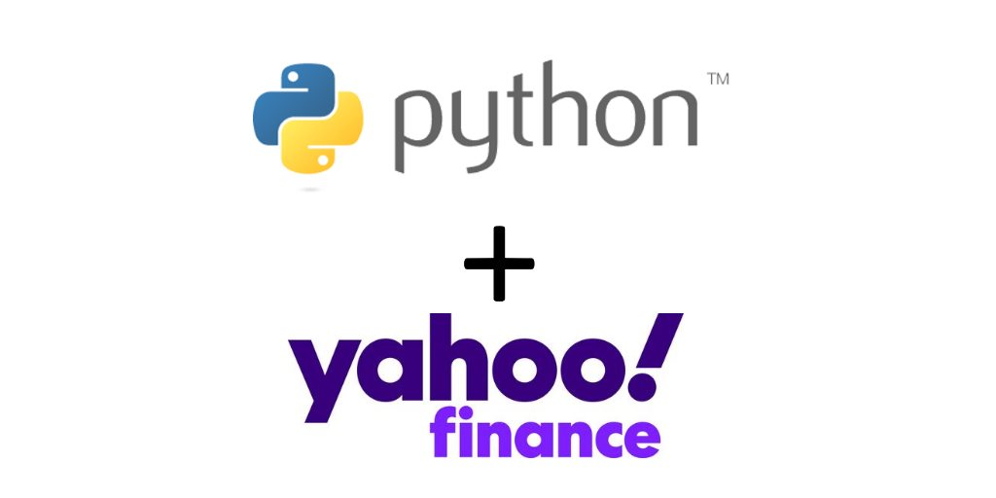
TECHNOLOGIES

Slide 12
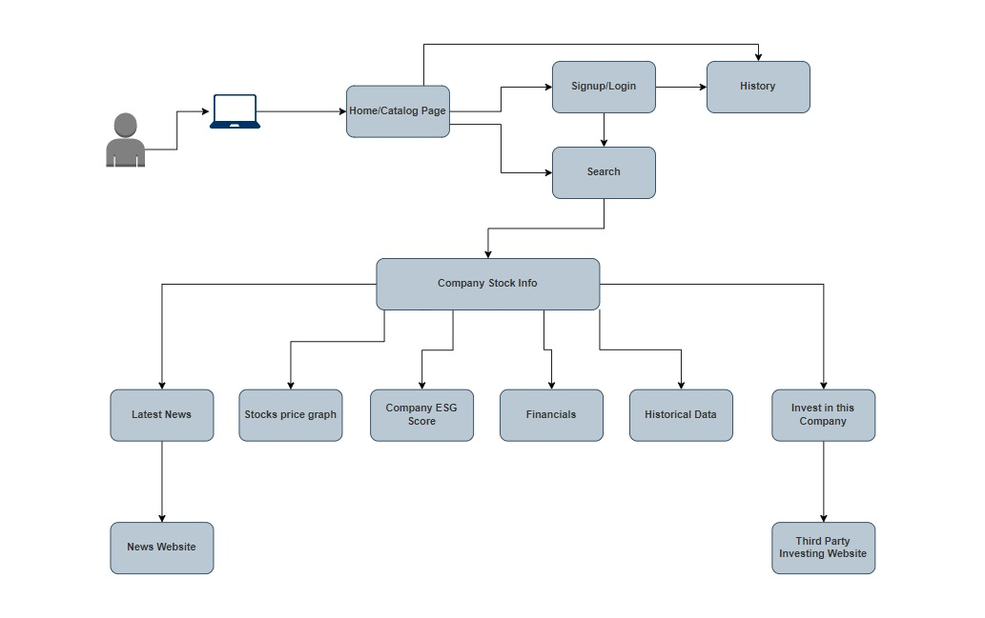
ARCHITECTURE

Slide 13
SPRINT 6 RECAP
User login feature has been implemented
Invest in this company button will redirect user to third party where user can now invest into stocks
PNG-formatted graphs can be downloaded to give users access to more stock insights.
The sequence of historical data in tabular form has been changed so that users can view the most recent data first and then older data.

Slide 14
SPRINT 6 VS SPRINT 7
SPRINT 6
User login feature has been implemented
Invest in this company button will redirect user to third party where user can now invest into stocks
PNG-formatted graphs can be downloaded to give users access to more stock insights.
The sequence of historical data in tabular form has been changed so that users can view the most recent data first and then older data.
SPRINT 7
Improved user interface for login and sign-up page
Added search history tab for registered user
Implemented news headlines section for user to know more about current scenarios of company
Notes:
Change this

Slide 15
IMPROVEMENTS MADE FROM PROFESSOR FEEDBACK
Architecture needs improvement.
Updated Architecture diagram of DOSRI website
Sprint backlog needs improvement based on user stories as well.
Updated sprint backlog which correlates with user stories
Product backlog needs to show tasks only.
Updated product backlog accordingly.
Need to add an API screenshot and the Webpages SS.
Added backend screenshots which shows API calls and requested data
Needs traceability in all the sprints test cases
updated test cases accordingly.
Sprint's future work needs to be in user story format.
No screenshots of jira have been added.

Slide 16
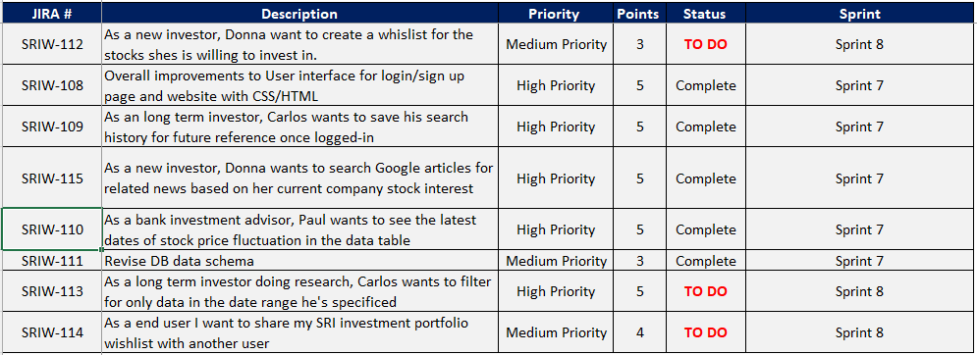
PRODUCT BACKLOG

Slide 17
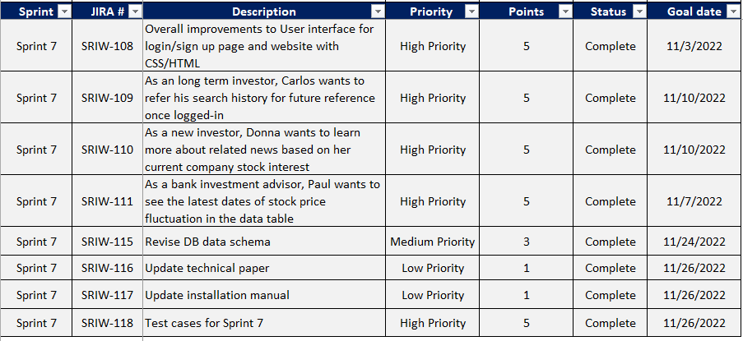
Sprint 7

Slide 18
USER STORY & ACCEPTANCE CRITERIA
SRIW 109
User Story:
As a Investor, I'd like to keep a track on search history of the company stocks i previously searched
Acceptance criteria:
Given that the investor is already on the page, he or she ones logged in they can they see the search history in the history tab on the Console/Home page

Slide 19
USER STORY & ACCEPTANCE CRITERIA
SRIW 111
User Story:
In order to provide my clients with beneficial returns, as an investment advisor, I should be aware about the latest date of the historical data on the site.
Acceptance criteria:
Given that the user is already on the page, he or she will type the firm name into the search field, which will display the company's historical trend in the historical data tab which will also show them the latest date for the updated data.

Slide 20
USER STORY & ACCEPTANCE CRITERIA
SRIW 110
User Story:
I want to be able to invest in socially conscious companies as a young, inexperienced investor, and I want to learn as much as I can about the particular firm before I buy any of its stocks.
Acceptance criteria:
Given that the user is already on the website, he or she will type the firm name into the search bar and click Submit. After submitting the companies name they can then see the recent headline article for the company they have searched.

Slide 21
SPRINT 7: TEST CASES
User story ID | TEST CASE ID | TEST CASES | EXPECTED RESULT | PASS/FAIL | TEST DATA
SRIW-109 | SRIW-119 | Reference previously searched company names | User should be able see all his search history | Pass | Once user on history page they can see the company they previously searched
SRIW-110 | SRIW-120 | Learn about latest news for the company searched | User should be able to see news headlines | Pass | Once user searches for the company’s stock they can see the latest headlines for the searched company
SRIW-110 | SRIW-121 | Learn about latest news of the company searched | User will be redirected to news article | Pass | Once user clicks on the headlines below the search box they can see the latest article
SRIW-111 | SRIW-122 | Latest calendar date for the historical data available | User can now see the most recent calendar date for the historical data | Pass | Once user goes to historical data they can see the late date for when the data was updated
Notes:
Jephthe

Slide 22
Stories Completed
USER STORY ID | AS A | I WANT TO | SO THAT | Acceptance Criteria
SRIW 109 | Long-term Investor | Keep track of search history | I can refer back to companies i searched before | Given that the investor is already on the page, he or she ones logged in they can they see the search history in the history tab on the Console/Home page
SRIW-110 | Inexperienced investor | Learn about latest online news of the company | I can see latest news headlines | Given that the user is already on the website, he or she will type the firm name into the search bar and click Submit. After submitting the companies name they can then see the recent headline article for the company they have searched.
SRIW-110 | Investment Advisor | Learn about latest online news of the company | User will be redirected to news article | Given that the user is already on the page, he or she will type the firm name into the search field, which will display the company's historical trend in the historical data tab which will also show them the latest date for the updated data.
Notes:
Jephthe

Slide 23
METRICS
TEAM VELOCITY
BURNDOWN CHARTS
COMMITTED/ COMPLETED RATIO

Slide 24
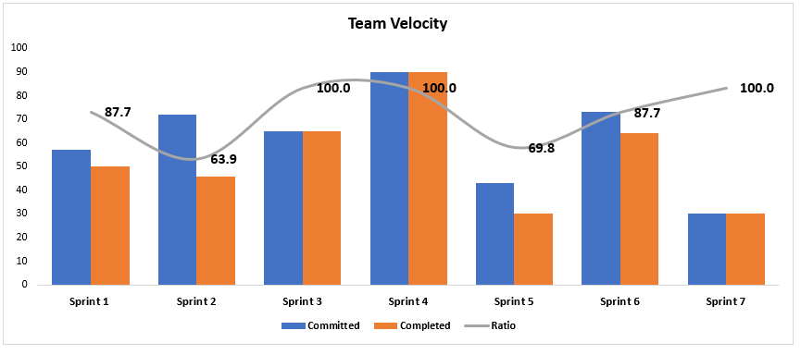
SPRINT 7: TEAM VELOCITY
Notes:
Jephthe

Slide 25
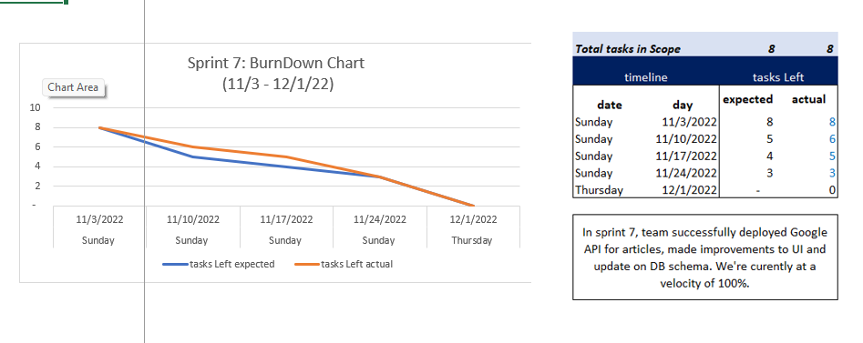
SPRINT 7: BURNDOWN CHART
Notes:
Jephthe

Slide 26
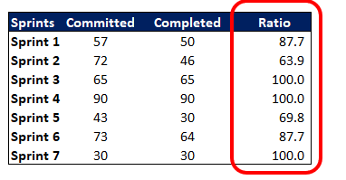
SPRINT 7:
COMMITTED/
COMPLETED RATIO
Notes:
jeph

Slide 27
RETROSPECTIVES

Slide 28
WHAT WENT WELL | WHAT NEEDS IMPROVEMENT | NEXT STEPS | Votes (OUT of 6)
-Participation amongst the team has continued to improve, everyone knows each other’s strengths | - Using maybe a messaging tool like Slack to raise questions instead of waiting when we meet or e-mailing | -Migrating conversations from email to possibly a chat Project Management tool like Slack | 6
-Team aligning on what is appropriate for MVP as of end of semester vs long term Product roadmap | - We need to find a better way to collaborate for backend work for AWS | -Review individual tutorials for AWS Cloud training and meeting with team to share insights | 6
- Continuous completion of tasks within the required timeline and identifying dependencies | - Getting team members to understand each others code faster for quicker completion of stories & tasks | - Setting up one separate meeting strictly for walking team through individual code | 6
Notes:
Jephthe

Slide 29
SPRINT 8 FUTURE WORK
ID | Description | Priority | Points | Status | Sprint
SRIW 112 | As a new investor, Donna want to create a wishlist for the stocks shes is willing to invest in. | Medium | 3 | TO DO | Sprint 8
SRIW-113 | As a long term investor doing research, Carlos wants to filter for only data in the date range he's specifices | High | 5 | TO DO | Sprint 8
SRIW-114 | As a end user I want to share my SRI investment portfolio wishlist with another user | Medium | 3 | TO DO | Sprint 8
Notes:
Harshal

Slide 30
PROJECT DEMO

Slide 31
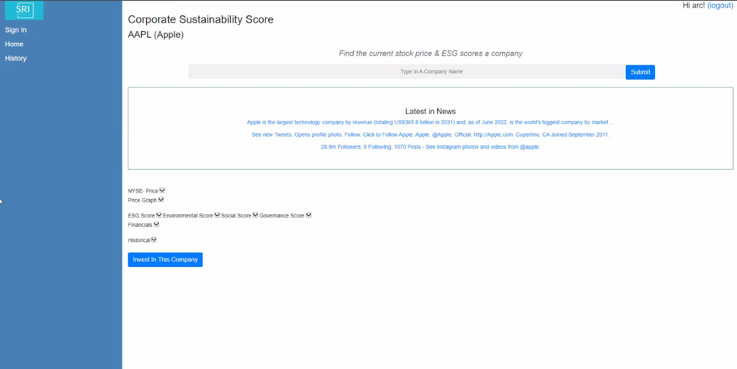
SCREENSHOTS OF THE WEBSITE

Slide 32
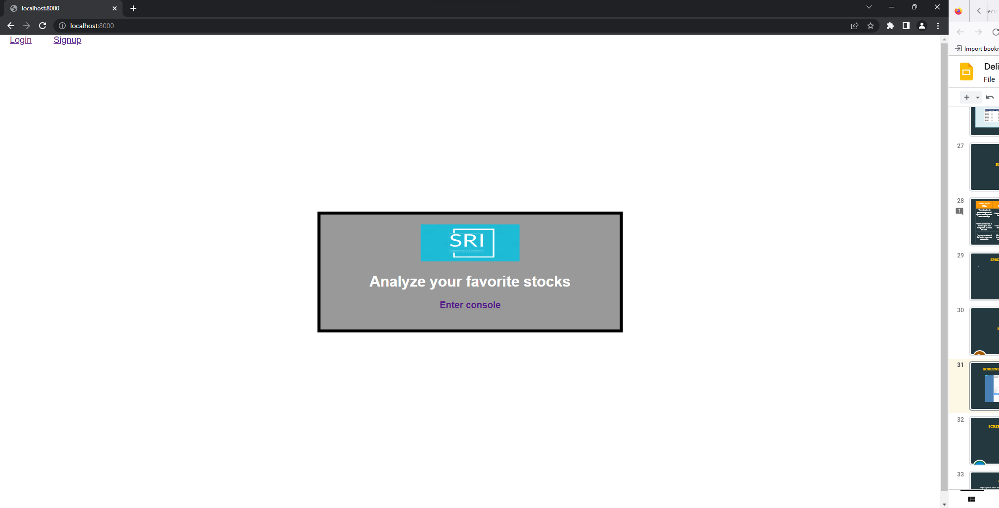

Slide 33
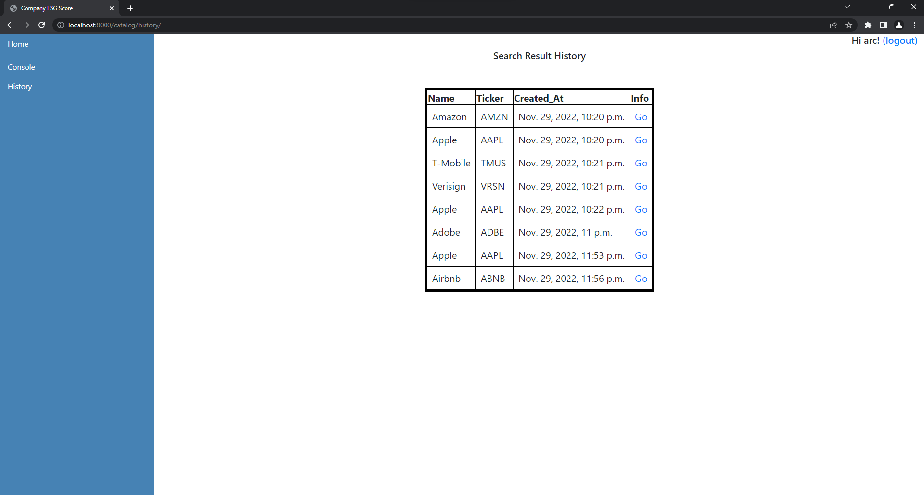

Slide 34
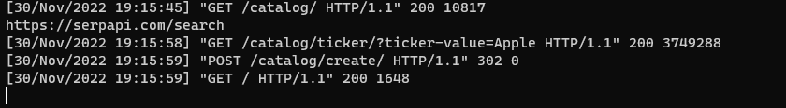
SCREENSHOTS OF THE API

Slide 35
GITHUB LINK
https://github.com/CS691/Socially-Responsible-Investing-A-financial-website/wiki

Slide 36
THANK YOU!

